Slide 1
NextHikes IT Solutions
Project – 5
User Analytics in the Telecommunication Industry
Name - Jameel
Post Graduate Program in Data Science & AI

Slide 2
User Overview Insights (Task 1)
Handset Market Dominance: A disproportionate majority of the top 10 handsets used on the network are premium devices manufactured by Apple (iPhones) and Samsung.
OEM Marketing Opportunities: Marketing teams should target the top 3 manufacturers (Apple, Samsung, and Huawei) (p. 2). Launching brand-specific device upgrade campaigns or trade-in programs will systematically migrate low-tier users to high-throughput devices.
Application Traffic Breakdown: Data volume consumption is heavily top-heavy.

Slide 3
Gaming and Youtube (Video Streaming) account for the absolute majority of network bandwidth (p. 3). In contrast, basic utilities like Email and Social Media generate minimal data footprints.
Heavy User Segments (Decile Class): Non-graphical univariate and decile analysis prove that the data distribution is heavily right-skewed (p. 3). The top 2 deciles (top 20% of users) consume a vast majority of the network’s total data volume.

Slide 4
User Engagement Insights (Task 2)
Customer Behavioral Clustering: The K-Means algorithm successfully classifies users into 3 distinct operational segments: High, Medium, and Low engagement cohorts based on session frequencies, duration, and traffic.
Resource Optimization: The High Engagement Cluster features users who remain connected for long durations and generate maximum data traffic.
Network Infrastructure Guidance: Technical teams must actively redirect infrastructure resources and optimize cell-tower bandwidth in localized geographical areas where high-engagement customer clusters are densely active (p. 4).

Slide 5
. User Experience Analytics (Task 3)
Hardware Bottlenecks: Customers operating older or lower-specification handset models suffer from elevated TCP Retransmission Volumes and high Round Trip Time (RTT) latencies. This hardware constraint degrades their perceived network performance.
Throughput Distribution: Average throughput spikes drastically among users carrying flagship LTE/5G smart devices. This proves that user device characteristics are directly gating application performance.
Quality of Service (QoS) Segments: K-Means clustering highlights a specific segment of users experiencing poor performance (Low Throughput, High Packet Drop Rate). These users represent the highest churn risk for TellCo.

Slide 6
Strategic Investment Recommendation & Limitations (Task 4 & Final)
Satisfaction Drivers: Customer satisfaction scores are directly tied to user experience. High throughput combined with low latency results in premium customer satisfaction vectors.
Undervalued Asset Potential: TellCo's current owners have completely neglected system-generated user data. This analytical void presents a massive business optimization opportunity for an incoming investor.

Slide 7
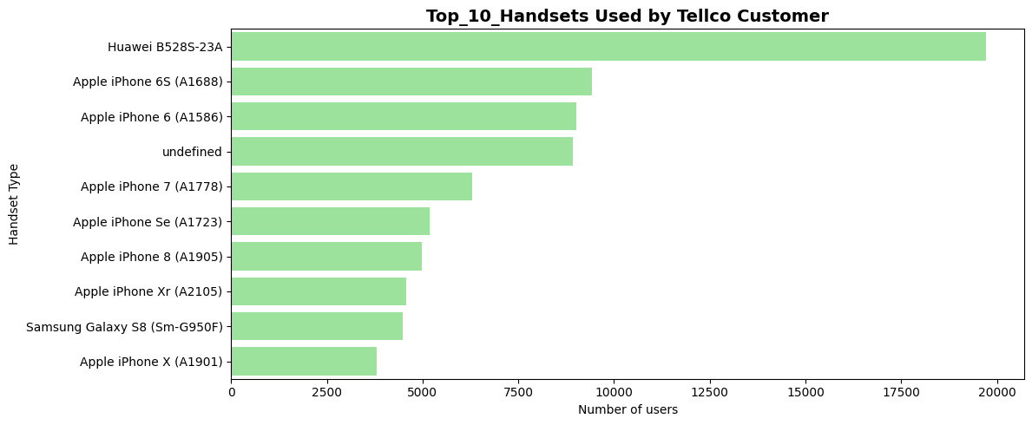
Top 10 Handset Used by Customer

Slide 8
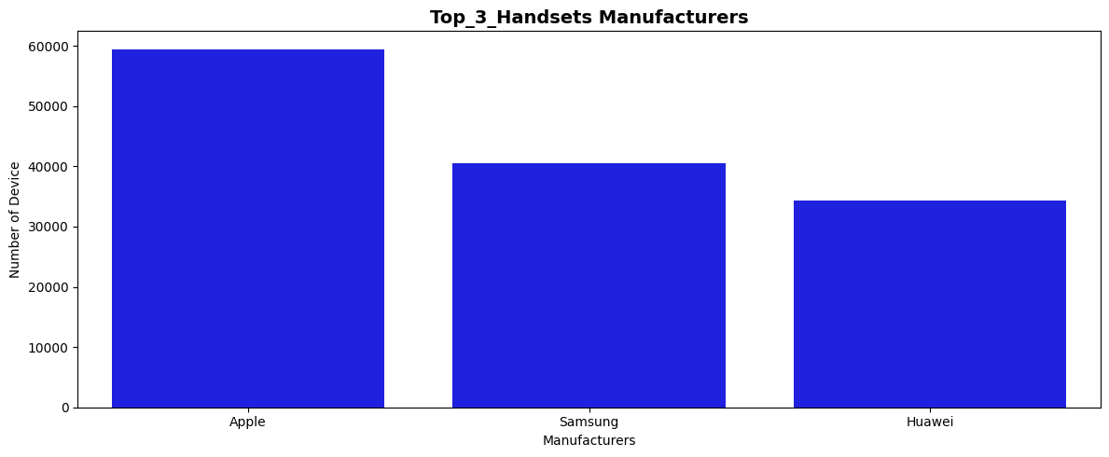
Top 3 Handset Manufacturers Company

Slide 9
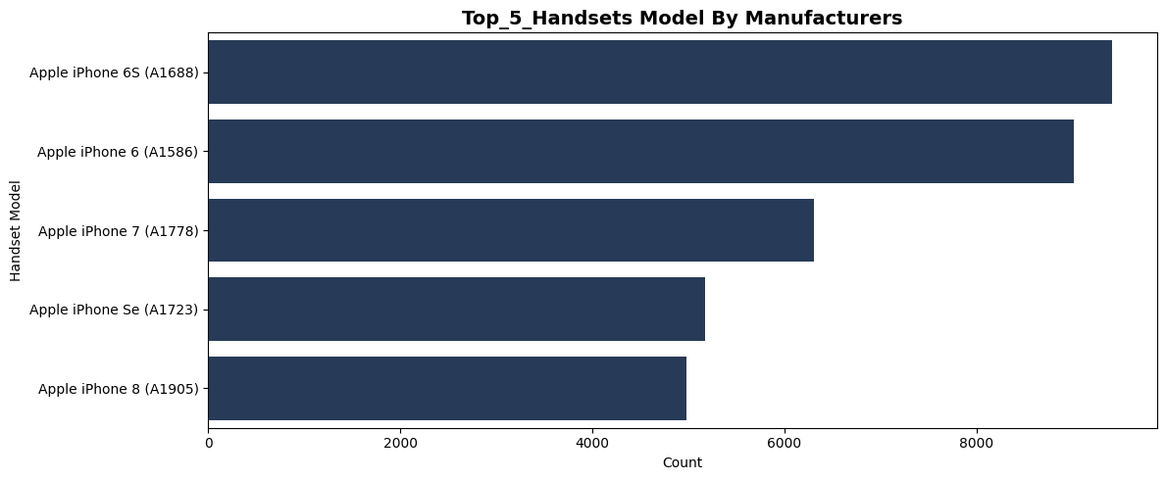
Top 5 handsets per top 3 handset manufacturer

Slide 10
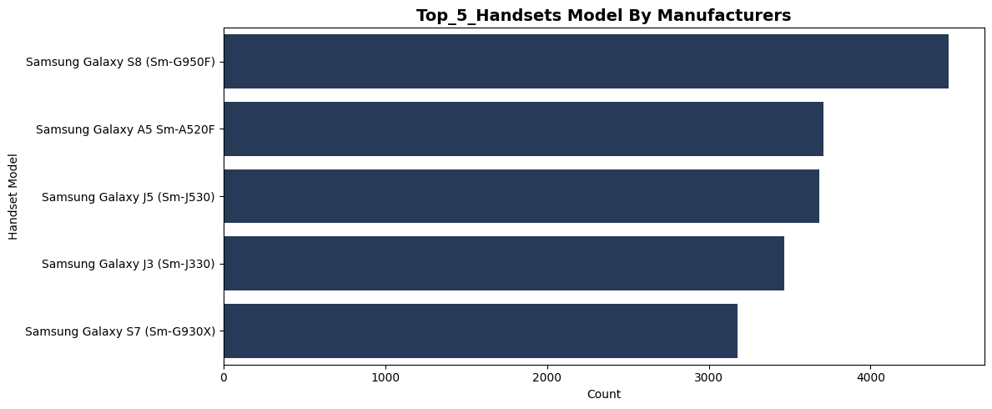
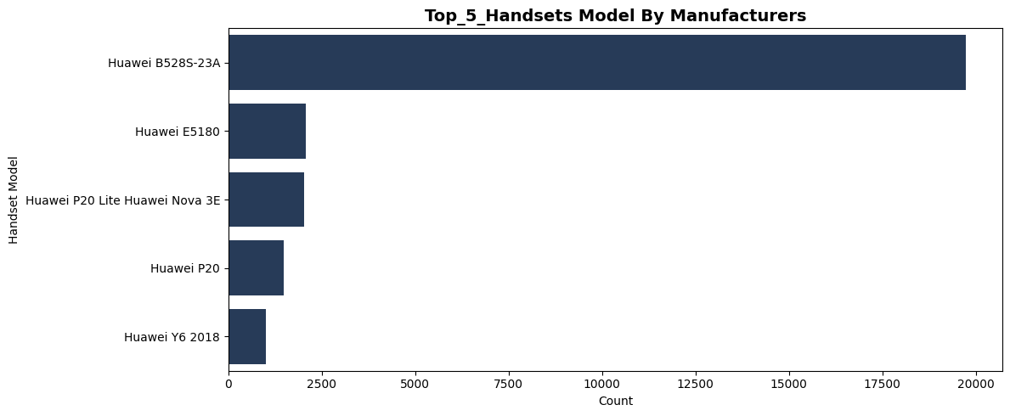

Slide 11
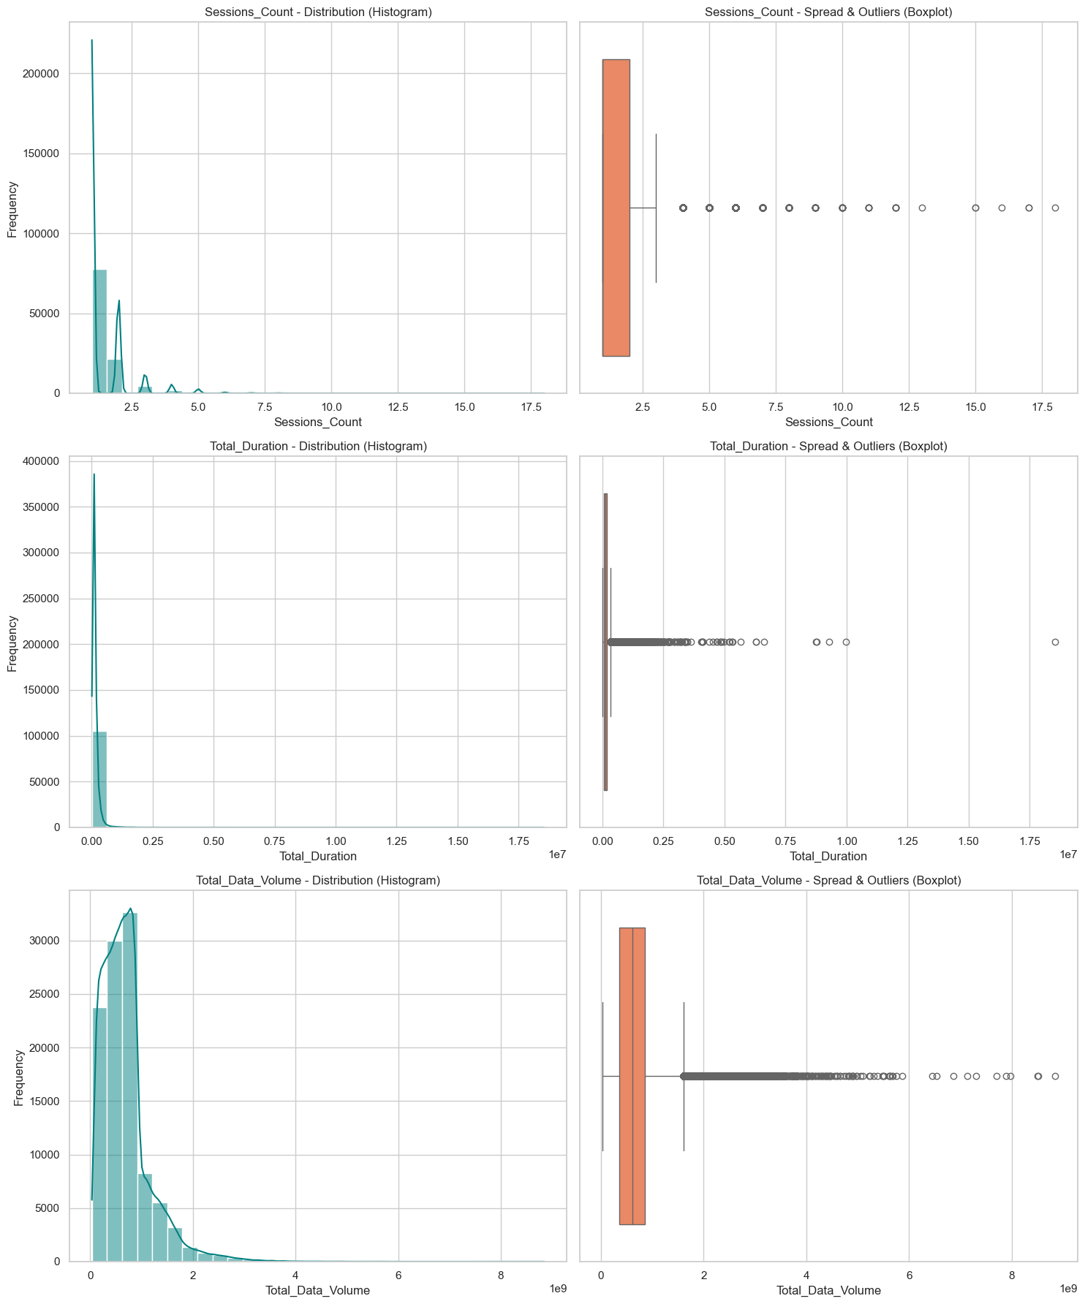

Slide 12
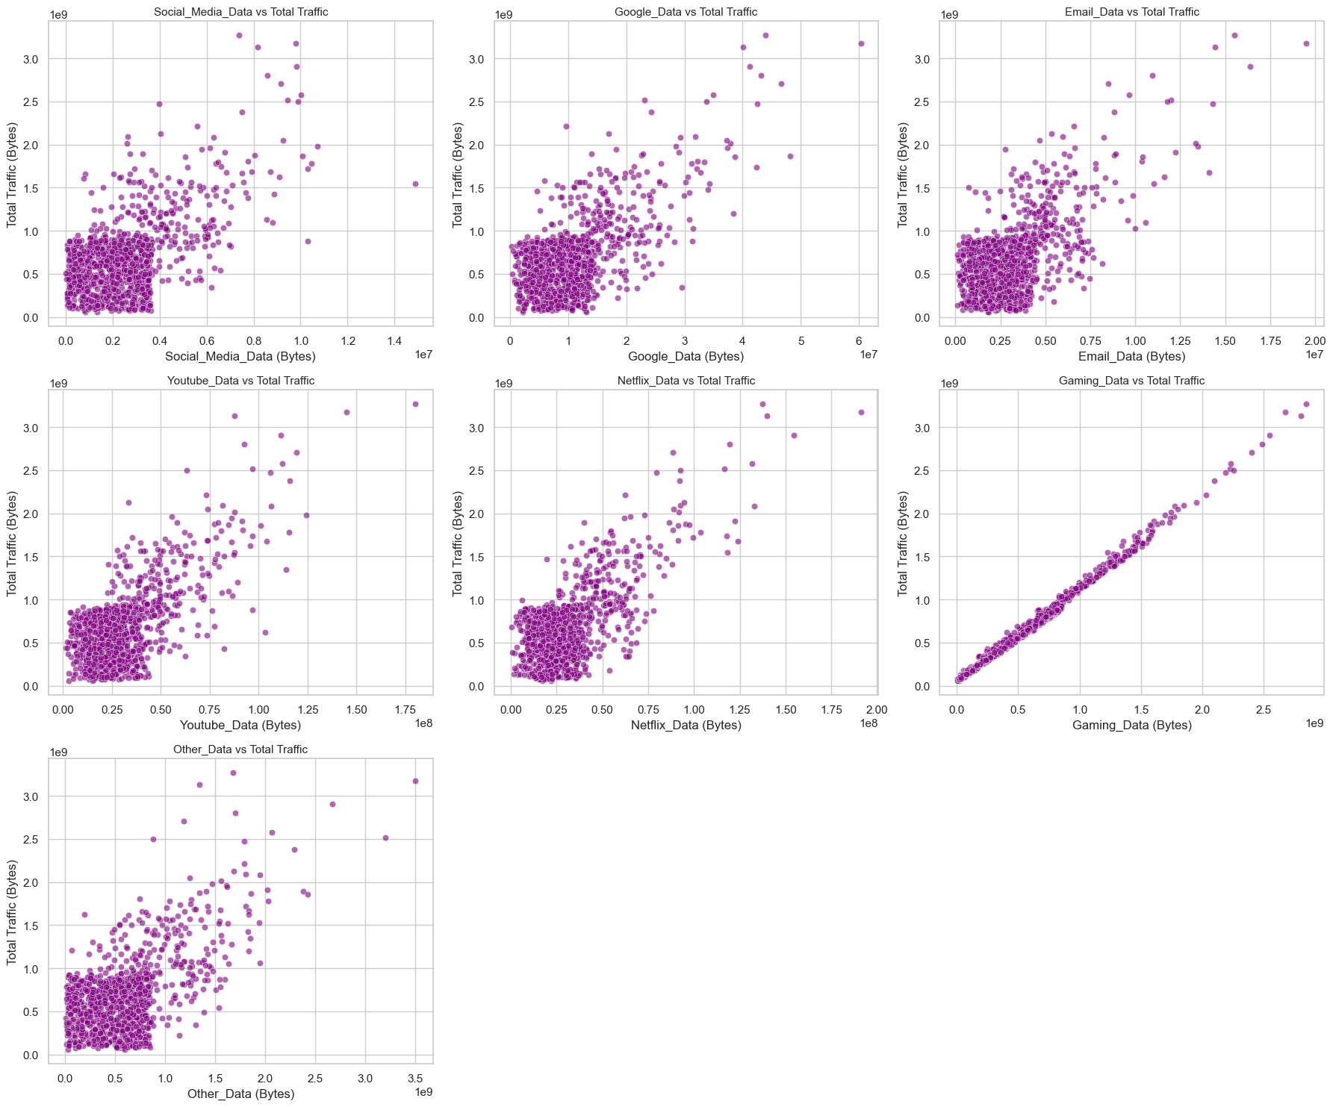

Slide 13
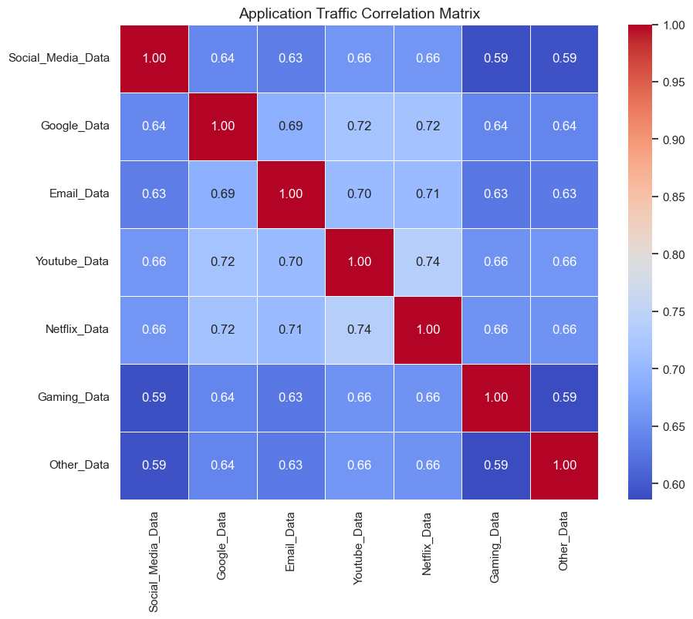

Slide 14
